Slide 1
How dos internet works.
Hans Randeris Nielsenn

Slide 2
www.jp.dk
Host = ip-adresse (DNS)
Service (http = port 80)

Slide 3
Internet

Slide 4
Pc on net

Slide 6
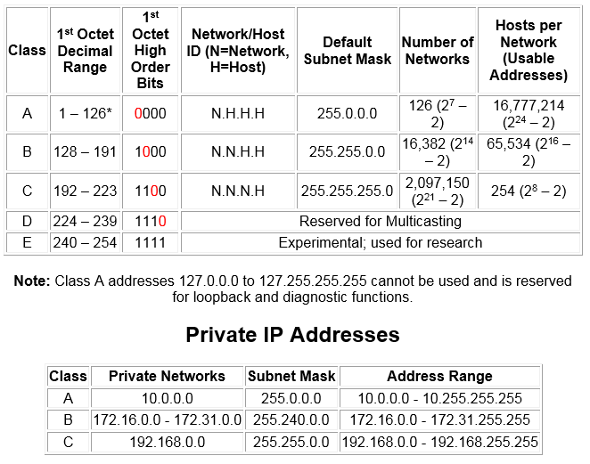
Ip

Slide 8
DHCP Request

Slide 9
DHCP ACK

Slide 10
ipconfig

Slide 11
ARP and rutetabel

Slide 12
DNS

Slide 13
DNS

Slide 14
DNS

Slide 16
MY net ?

Slide 17
Session to web server

Slide 18
Session to web server

Slide 19
streem

Slide 20
Wireshark

